Slide 1
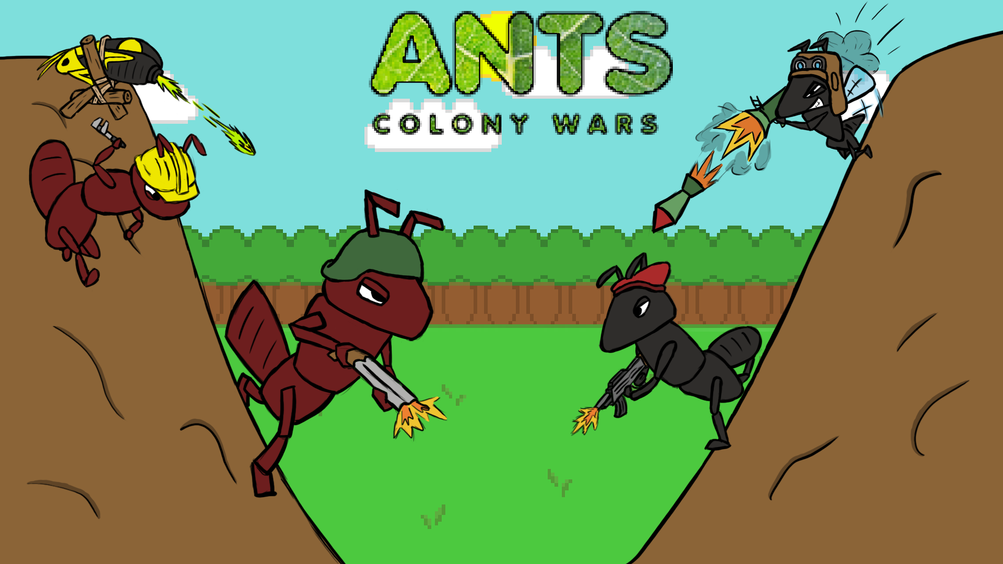

Slide 2
Game Synopsis (Stanley)
Ants: Colony wars is a 2D puzzle tactical artillery shooter. The game consists of two stages, a preparation stage (stage 1) and a combat stage (stage 2) inspired by the games ‘Lemmings’ and ‘Worms’ retrospectively.

Slide 3
Features in more detail (Stanley)
The first level is the preparation stage where the player has to guide numerous grubs throughout the stage whilst avoiding hazards (such as sudden drops or harmful water) using a main ant character. Once the grubs have either made it to the end of the level or perished along the way, the player is then transported to the second level (the combat stage)
In the combat stage two players then have to fight each other using a collection of different ant characters each with their own look and unique abilities. Each player gets more health depending on how many grubs the player kept alive in the first stage. Using each character in a turn based style, the player has to eliminate their opponents dotted around the level.

Slide 4
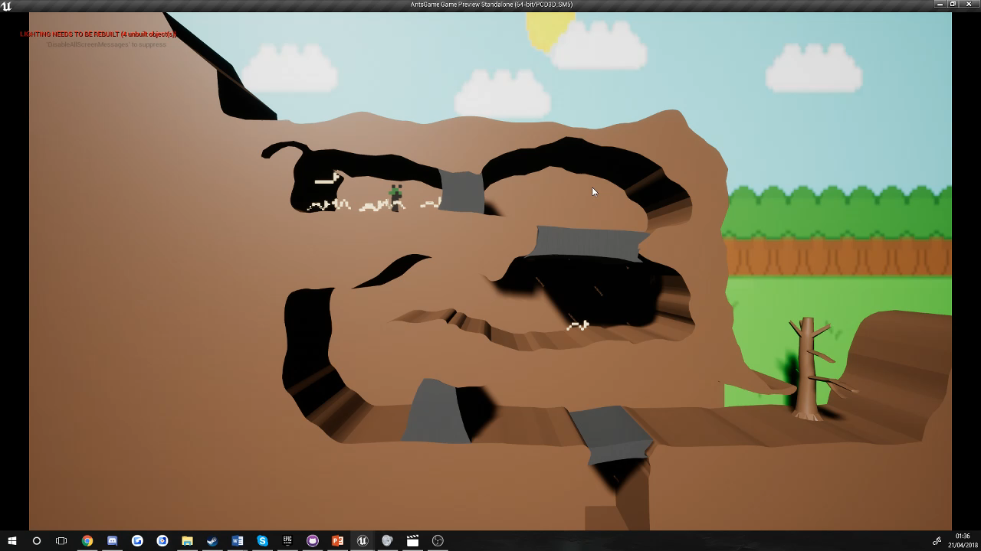
Gameplay from each level 1 (Stanley)

Slide 5
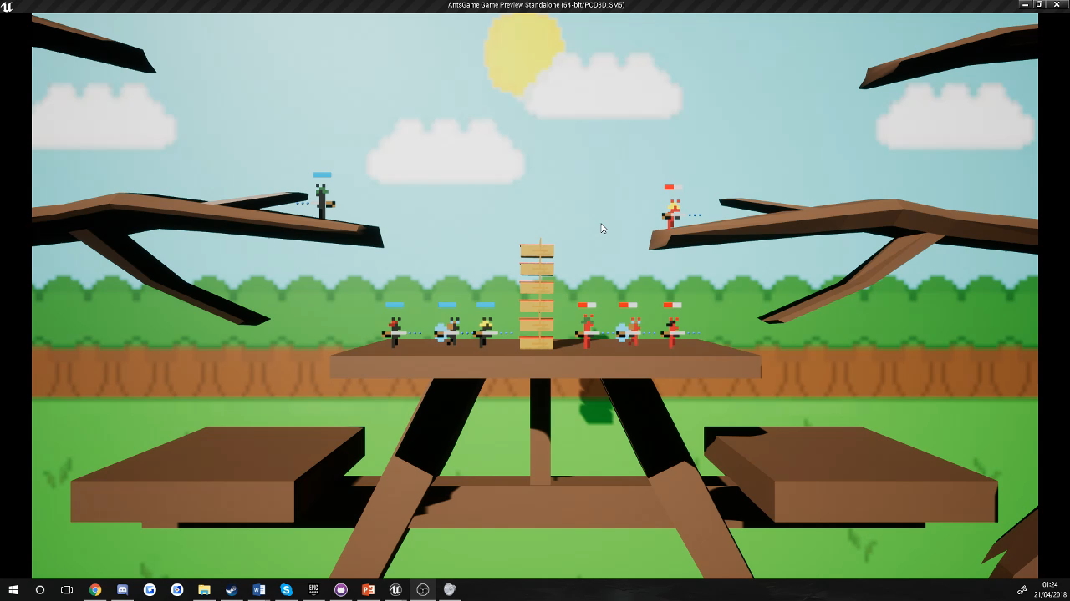
Gameplay from each level 2 (Stanley)

Slide 6
Sprites and characters (Harry)
Describe the characters, their looks and abilities.

Slide 7
Concept art from paper to engine (Harry)
Screenshots of concept art for sprites
Screenshots/gifs of sprites in engine
Side by side comparison.

Slide 8
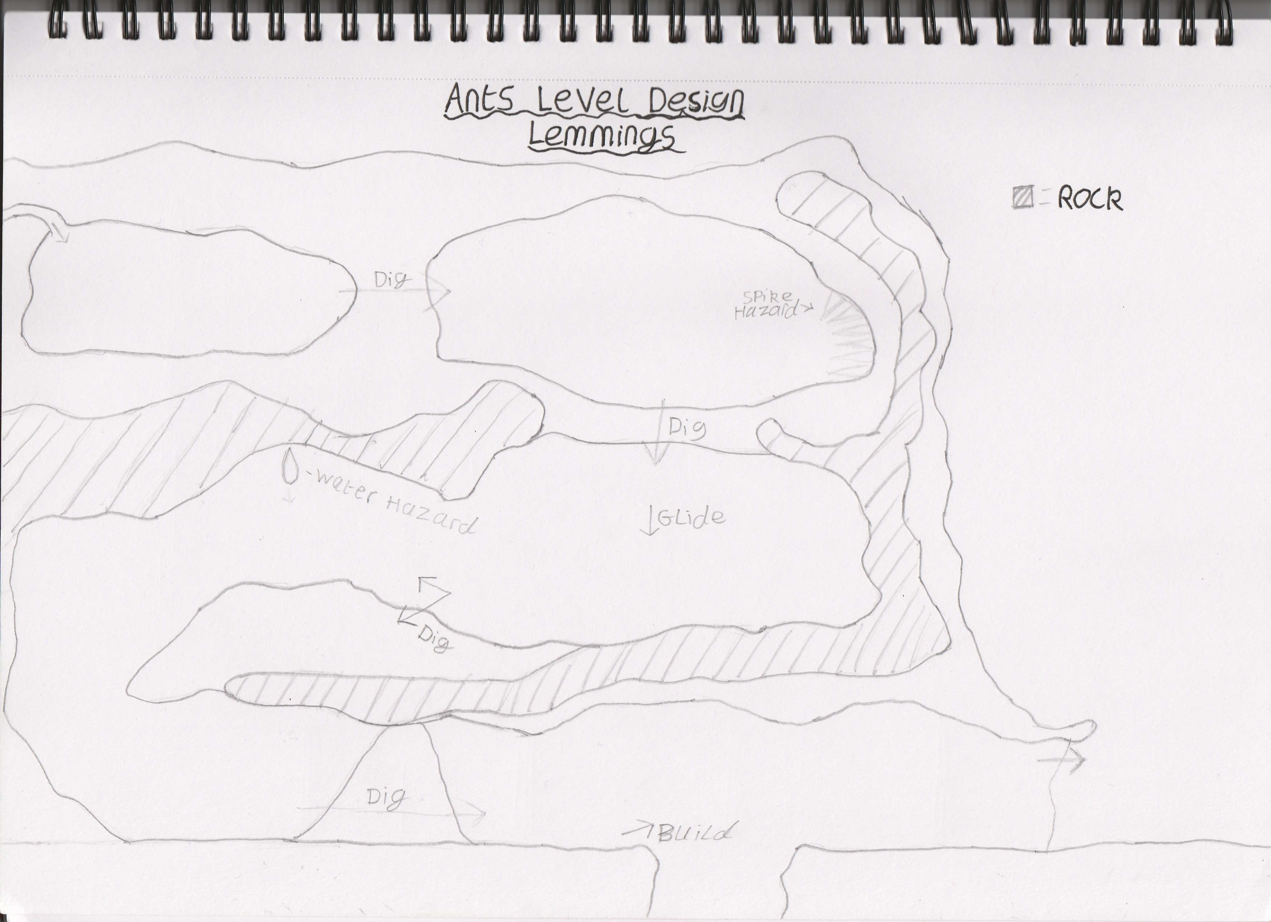
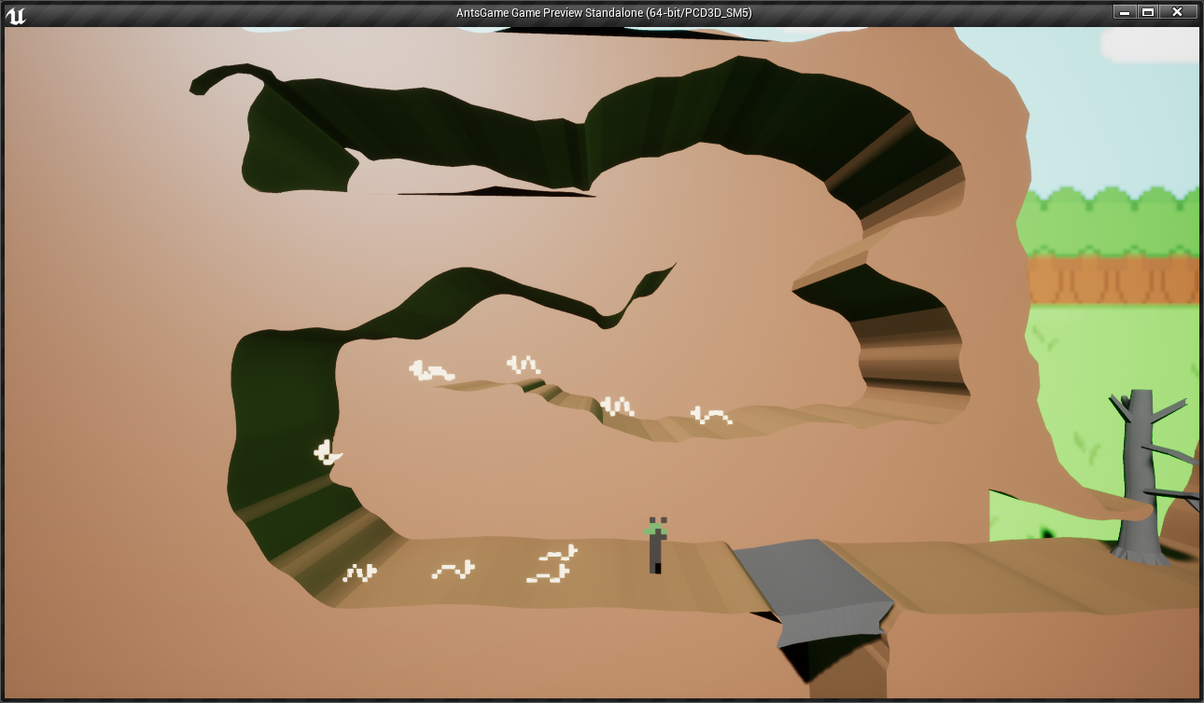
Level design from concept to engine (Stanley)

Slide 9
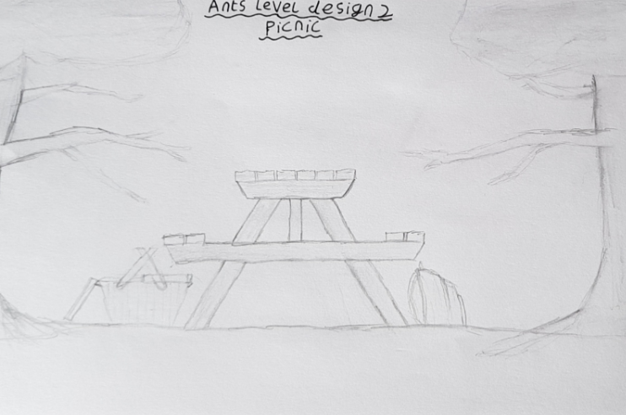
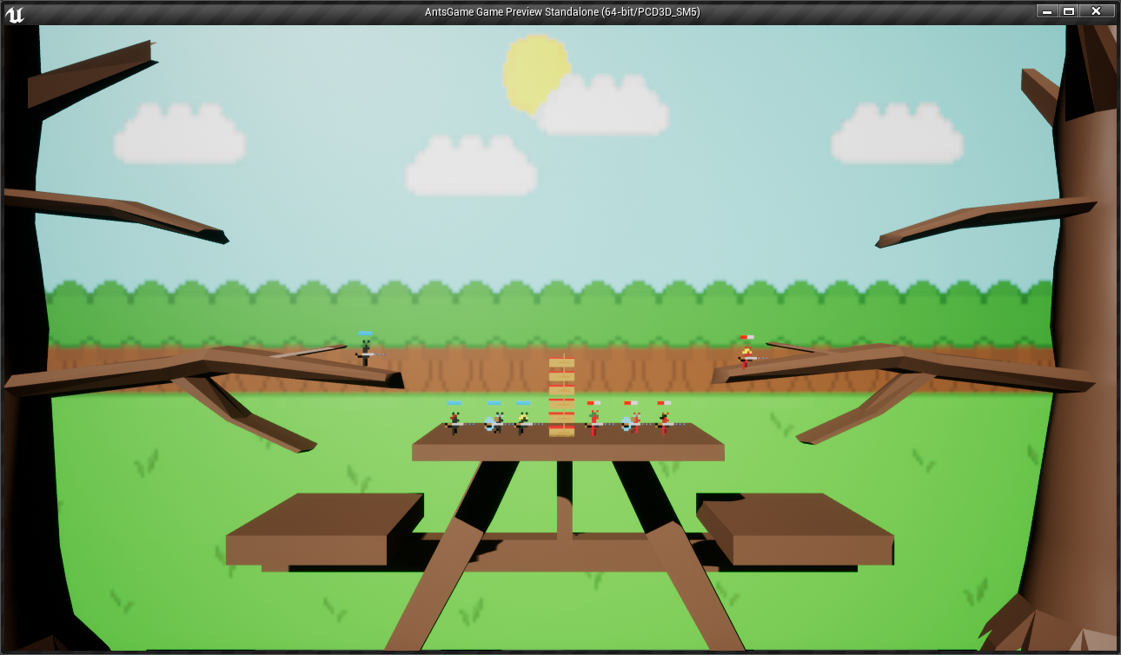
Level design from concept to engine (Stanley)

Slide 10
Extra features added (Danny)

Slide 11
Bugs – Coding (Gary)

Slide 12
Bugs – Graphics (Gary)
Original picnic table – fixed by recreating in Maya or 3ds MAX
Sprite animations not playing properly
If the level isn’t even the ants can fall off
Character gets sent flying if it stands on a destructible bit of terrain

Slide 13
Conclusion (Danny)
What we learnt
Team dynamics
What went well
What could’ve been better
How we felt about the game

Slide 14
What have we learnt

Slide 15
Team dyanmics

Slide 16
What went well

Slide 17
What could have been better

Slide 18
Overall Thoughts

